Slide 1
KRISO Project Report

Slide 2
Contents
Survey report
General flow
Truck detection
License plate recognition
Container code recognition
Architecture implementation report
General architecture
Progress
Problems
Plan

Slide 3
Survey report
December 23, 2020

Slide 4
Research Direction Flowchart
Truck detection
License plate recognition
Container code recognition
Truck number recognition
Truck direction recognition
Detection
Segmentation
Recognition

Slide 5
License plate recognition
(1)
Standard format – Private vehicles:
(1) Vehicle types:
01 -> 69: typical passenger vehicles
70 -> 79: vans, recreational vehicles, coaches
80 -> 97: freight vehicles (truck) (*)
98 -> 99: specialized vehicles (e.g., tow trucks)
(2) Vehicle types:
100 -> 699: typical passenger vehicles
700 -> 799: vans, recreational vehicles, coaches
800 -> 979: freight vehicles (truck) (*)
980 -> 999: specialized vehicles (e.g., tow trucks)
(#)## L ####
(2)
(3)
(4)

Slide 6
License plate recognition
(1)
Standard format – Private vehicles:
(3) Letter:
Private vehicles: 가, 나, 다, 라, 마, 거, 너, 더, 러, 머, 버, 서, 어, 저, 고, 노, 도, 로, 모, 보, 소, 오, 조, 구, 누, 두, 루, 무, 부, 수, 우, 주
Rental cars: 허, 하,호
(4) 1000 -> 9999, assigned separately regardless of car type
(#)## L ####
(2)
(3)
(4)

Slide 7
License plate recognition
(1)
(2)
[Province/City]##
L ####
Standard format - Commercial vehicle:
(1) Province/City name written full in 한글, minus 도 or 시 suffix: 강원, 경기, 경남, 광주, 대구, 대전, 부산, 서울, 세종, 울산, 인천, 전남, 전북, 제주, 충남, 충북
(2) Vehicle types:
11 -> 69: taxi
70 -> 79: vans, buses
80 -> 97: freight vehicles (truck) (*)
98 -> 99: specialized vehicles (e.g., recreational vehicles)
(3)
(4)

Slide 8
License plate recognition
(1)
(2)
Standard format - Commercial vehicle:
(3) Letter:
Private vehicles: 바, 사, 아, 자
Rental cars: 허, 하,호
(4) 1000 -> 9999, assigned separately regardless of car type
[Province/City]##
L ####
(3)
(4)

Slide 9
License plate recognition
Difficulties
License plate deflection: license plate tilts (vertical tilt, horizontal tilt, or both) may cause character distortion and adversely affect character recognition.
Image with noise: in the real scene, the license plate image will distort suffered by rain line, snow line and other noises, and some license plates might be defaced.
Fuzzy license: license plate usually occupies a smaller proportion in the image, which might cause challenges due to their low resolution and noisy representation.

Slide 10
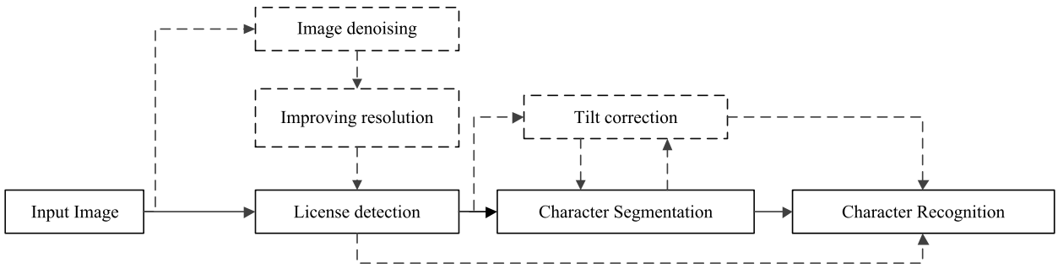



License plate recognition
General process:
Detection/Localization
Segmentation (*)
Recognition

Slide 11
License plate recognition
Detection: extract a portion area containing the potential license plate from the input image
Direction | Direct detection | Indirect detection
Description | Directly predict the location and height and width of license plate by feeding the input picture | Take advantage of the prior knowledge between the license plate & the truck
Pros | Low computational cost | High accuracy
Cons | Low accuracy | High computational cost

Slide 12
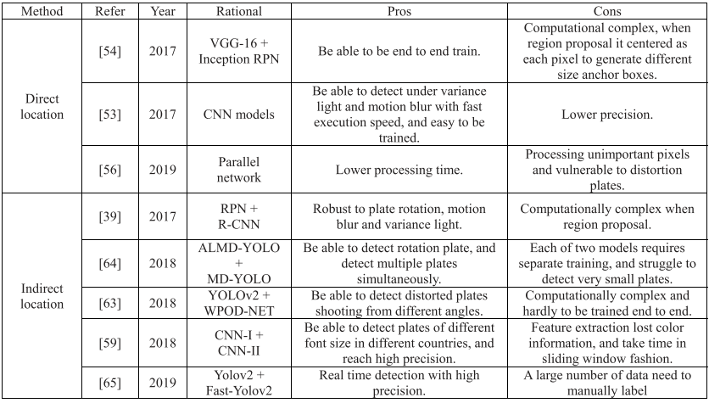
License plate recognition
Recent detection algorithms:

Slide 13
License plate recognition
Recognition:
The recognition algorithms based on segmentation divide the vehicle license plate into single characters.
The recognition algorithms based on segmentation-free transform the vehicle license plate recognition problem into character sequence labeling.

Slide 14
License plate recognition
Recent recognition algorithms:
 | Model(s) | Pros | Cons
Segmentation based | SCNN + RCNN | Can recognize under various illumination | Be sensitive to distorted and occlusion conditions
 | RANSAC + STN + CNN | Weight sharing used in the method could make full use of training set | Can’t suitably segment new energy & two-low layout license plates
 | PCA + MA | Can reconstruct blur & occluded characters | May cause over-segmentation
Segmentation-free based | Fast-YOLO | Fast | Low precision
 | BRNN+CTC | Can train end-to-end & robust to various illumination | Be sensitive to distortion and occlusion
 | RNN+CTC | Fully use contextual information & high precision | Unable to use in real-time
 | STN+CNN+BRNN+CTC | Can train end-to-end & simultaneously recognize characters and numbers | Limited to the assumption of the layout & can’t recognize plates in 2 rows
 | Modified –Deeplab-V2-ResNet+CCA+AlexNet | Recognize pixel-by-pixel so robust to individual miss prediction | Fixed count of characters & fail to recognize other layout plates

Slide 15
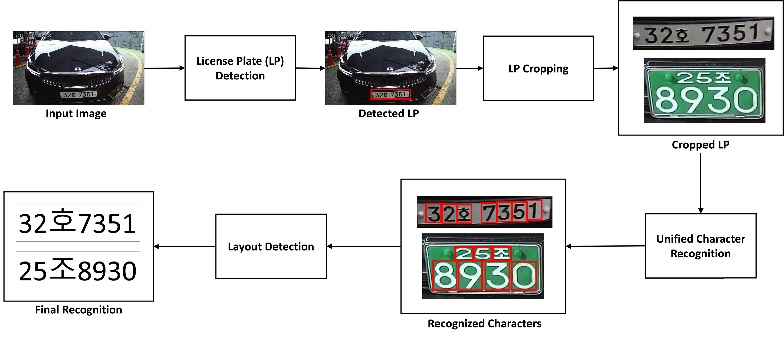
License plate recognition
Korean articles:
Multinational License Plate Recognition Using Generalized Character Sequence Detection (2020)
tiny-YOLOv3
YOLOv3-SPP

Slide 16
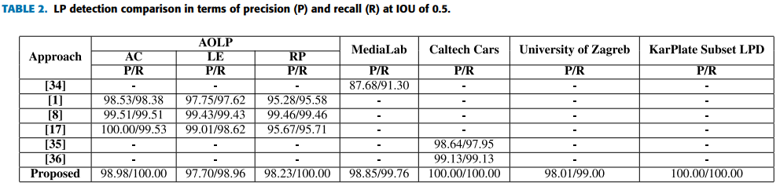
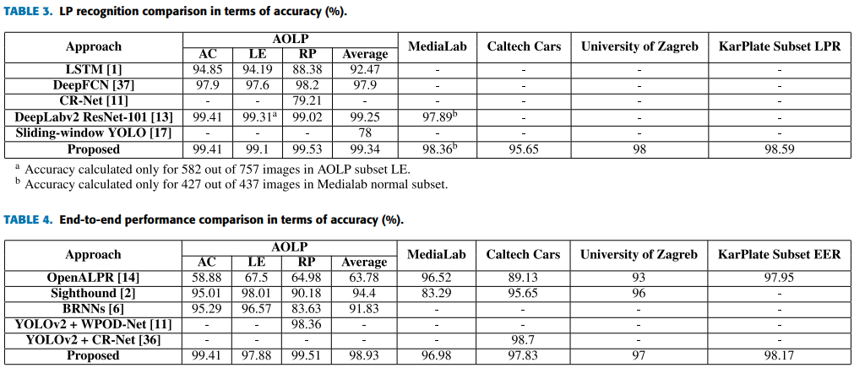
License plate recognition
Korean articles:
Multinational License Plate Recognition Using Generalized Character Sequence Detection (2020)

Slide 17
License plate recognition
Korean articles:
Multinational License Plate Recognition Using Generalized Character Sequence Detection (2020)

Slide 18
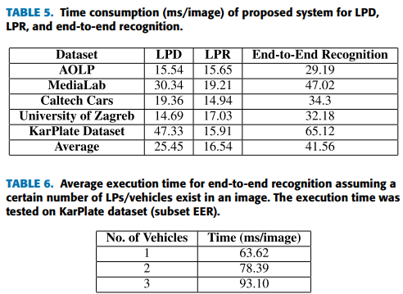
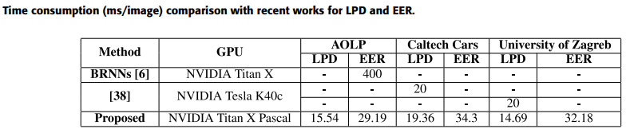
License plate recognition
Korean articles:
Multinational License Plate Recognition Using Generalized Character Sequence Detection (2020)

Slide 19
License plate recognition
Korean articles:
Real-time Automatic License Plate Recognition System using YOLOv4 (2020)
License plate detection
Character recognition
YOLOv4

Slide 20
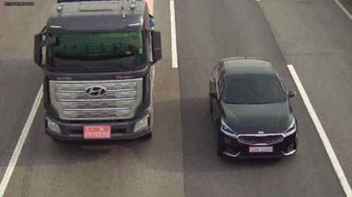
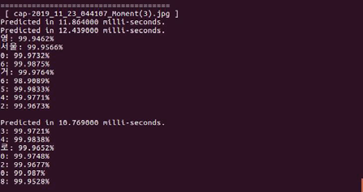


License plate recognition
Korean articles:
Real-time Automatic License Plate Recognition System using YOLOv4 (2020)

Slide 21
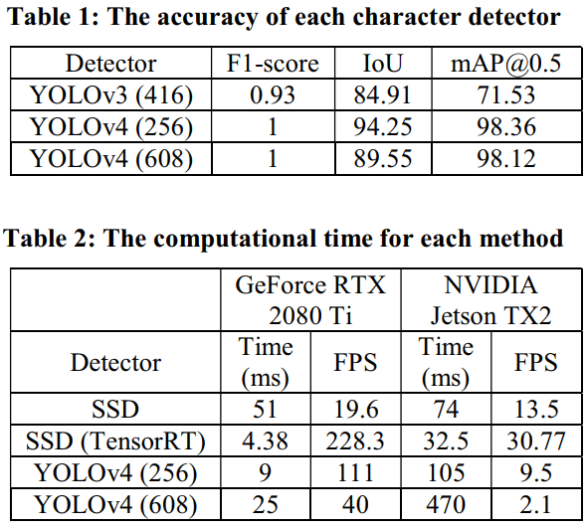
License plate recognition
Korean articles:
Real-time Automatic License Plate Recognition System using YOLOv4 (2020)

Slide 22
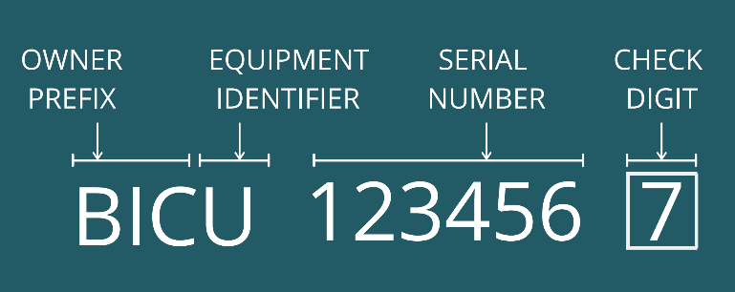
Container code recognition
Standard format (ISO-6346):
Owner prefix: first three capital letters
Equipment category identifier:
U: freight container
J: detachable freight container
Z: trailers and chassis
Serial/Registration number: decided by the owner
Check digit: determine whether the entire code is valid or not

Slide 23
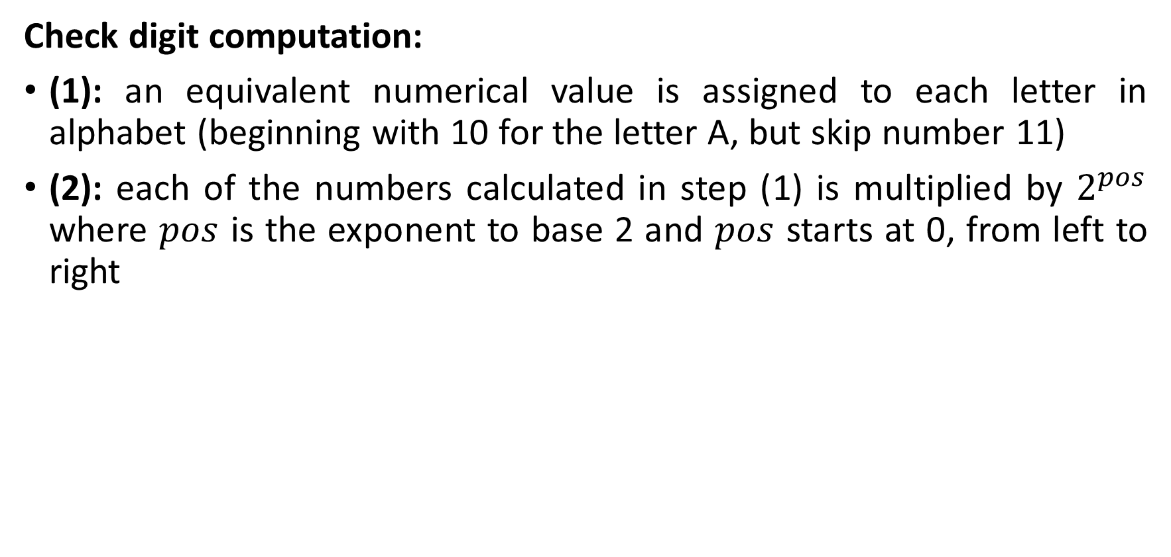
Container code recognition
Check digit computation:
(1): an equivalent numerical value is assigned to each letter in alphabet (beginning with 10 for the letter A, but skip number 11)
(2): each of the numbers calculated in step (1) is multiplied by $2^{pos}$ where $pos$ is the exponent to base 2 and $pos$ starts at 0, from left to right

Slide 24
Container code recognition
Check digit computation:
(3):
(3.1): summarize up all results of step 2
(3.2): divide the result by 11
(3.3): round the result down towards 0
(3.4): multiply the integer value by 11
(3.5): subtract result of (3.4) from result of (3.2), the result is check digit

Slide 25
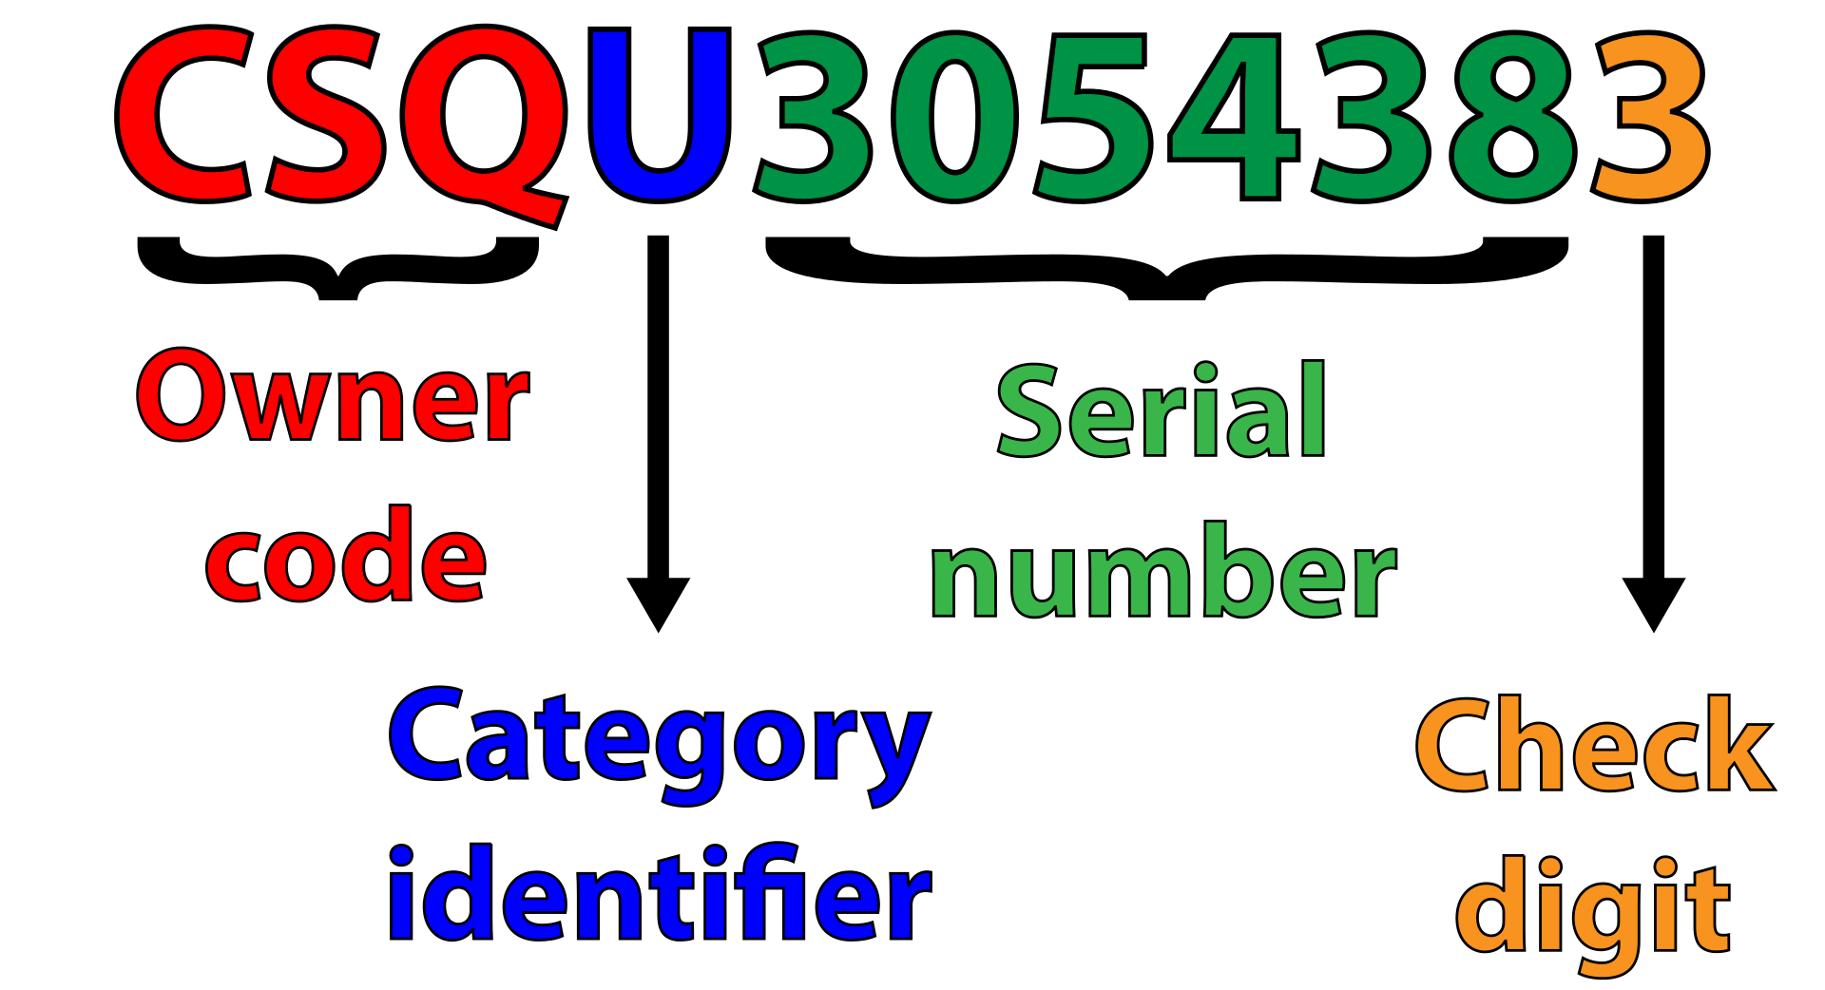
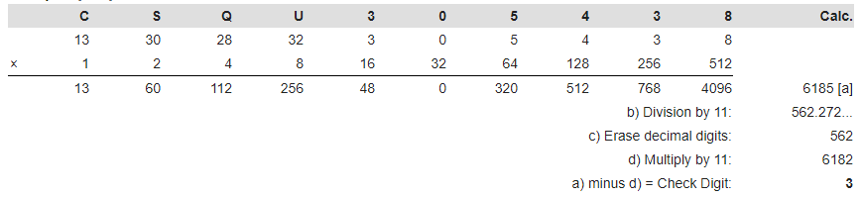
Container code recognition
Check digit computation:

Slide 26
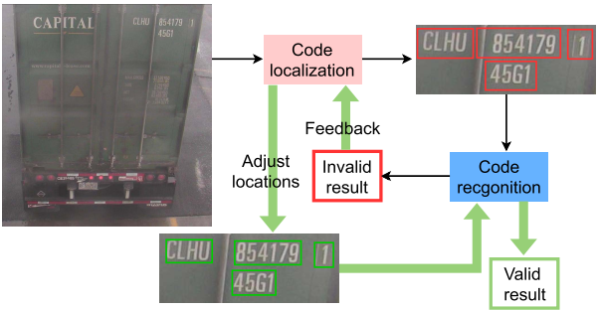
Container code recognition
Good articles:
An Adaptive Deep Learning Framework for Shipping Container Code Localization and Recognition (2020)
Extract feature & upscale by ResNet +Unet
Remove the low confidence regions & noisy areas by ASA
Merge overlapped detected areas by ASMR
CRNN

Slide 27
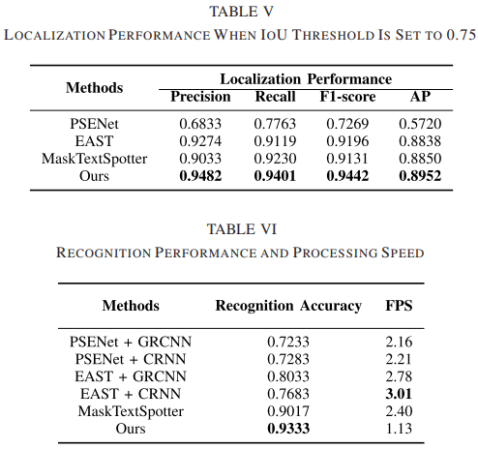
Container code recognition
Good articles:
An Adaptive Deep Learning Framework for Shipping Container Code Localization and Recognition (2020)

Slide 28
Container code recognition
Good articles:
A Hybrid Model for Container code Detection (2020)
Faster R-CNN
Horizontal container code?
PSENet
CRNN
Container code detection
Get bounding box
Yes
Container code text detection
Container code recognition
No
Rotation transform

Slide 29
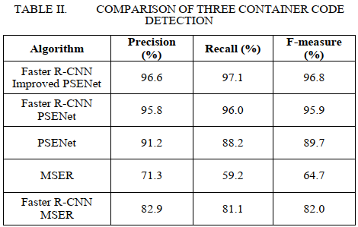
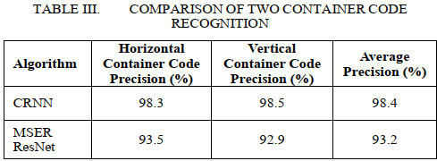
Container code recognition
Good articles:
A Hybrid Model for Container code Detection (2020)

Slide 30
Architecture Implementation Report
January 06, 2021

Slide 31


General architecture
LICENSE PLATE
Truck detection
Characters detection
Use YOLOv4 for detection
CONTAINER CODE
Confirm that the truck entered the ROI
Determine the view (front, back, top, left, right)
TRUCK NUMBER
Pre-processing
Denoise
Correct skew
Recognition
Put into OCR model(s) to recognize the characters (Tesseract, CRNN…)
Post-processing
Improve accuracy based on standard formats & prior data

Slide 32
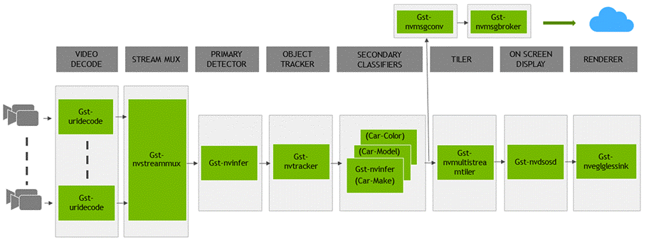

Slide 33
Progress
Install Virtual Machine Linux (Ubuntu 18.04)
Configure Jetson NANO Board
Configure IDIS camera
Test YOLOv4 and some OCR models (Tesseract, CRNN) on NANO Board:
With offline video data
With streaming video data (via RTSP)

Slide 34
Problems
NANO Board has a very low performance when running with streaming video data
IDIS camera is not compatible with Linux (only support Windows)
Current OCR inference models have low accuracy on Korean license plates

Slide 35
Plan
Try optimizing YOLO model to improve the performance
Find a suitable OCR solution for each recognition task
Find a suitable solution to connect Jetson Nano with Linux server

Slide 36
Project Report
January 11, 2021

Slide 37
Progress
Testing OCR inference models
Commercial: Google Vision API, Naver Clova, Plate Recognizer, ConDPS…
Open source: Tesseract, Open ALPR, Korean Car LPR, ALPR Korea…
Testing frame controller libraries: DeepStreams, ffmpeg, OpenCV

Slide 38
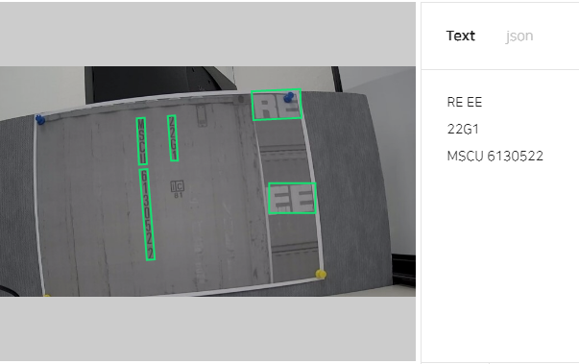
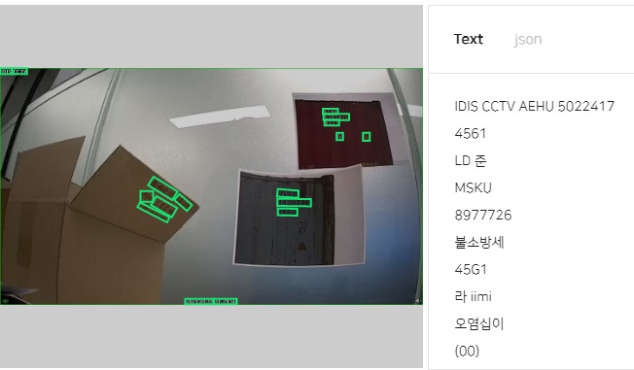
Recognition results from Naver Clova

Slide 39
Project Report
January 22, 2021

Slide 40
Architecture
License plate recognition
Image capture and processing
Detection
Storage
Managing through ID
Container code recognition
Metadata export
Truck
Container code
Display
Truck number recognition
License plate
Truck number
Tracking

Slide 41
Architecture
License plate recognition
Video decoding and pre-processing
Detection
Storage
Managing through ID
Container code recognition
Metadata export
CCTV Camera
Truck
Container code
Display
Truck number recognition
License plate
Output Interface
Truck number
Tracking
Jetson Nano

Slide 42
Plan
Deploy & test the detection model for each task on Jetson Nano as follows;
Truck detection, License Plate, Container Code and Truck number
Deploy & test the recognition model for each task on Jetson Nano as follows;
License Plate, Container Code and Truck number
Evaluate the performance of several frame controller libraries on Jetson Nano to choose the best one.

